Slide 1

Rashtriya Swayamsevak Sangh
Application Icon

Slide 2
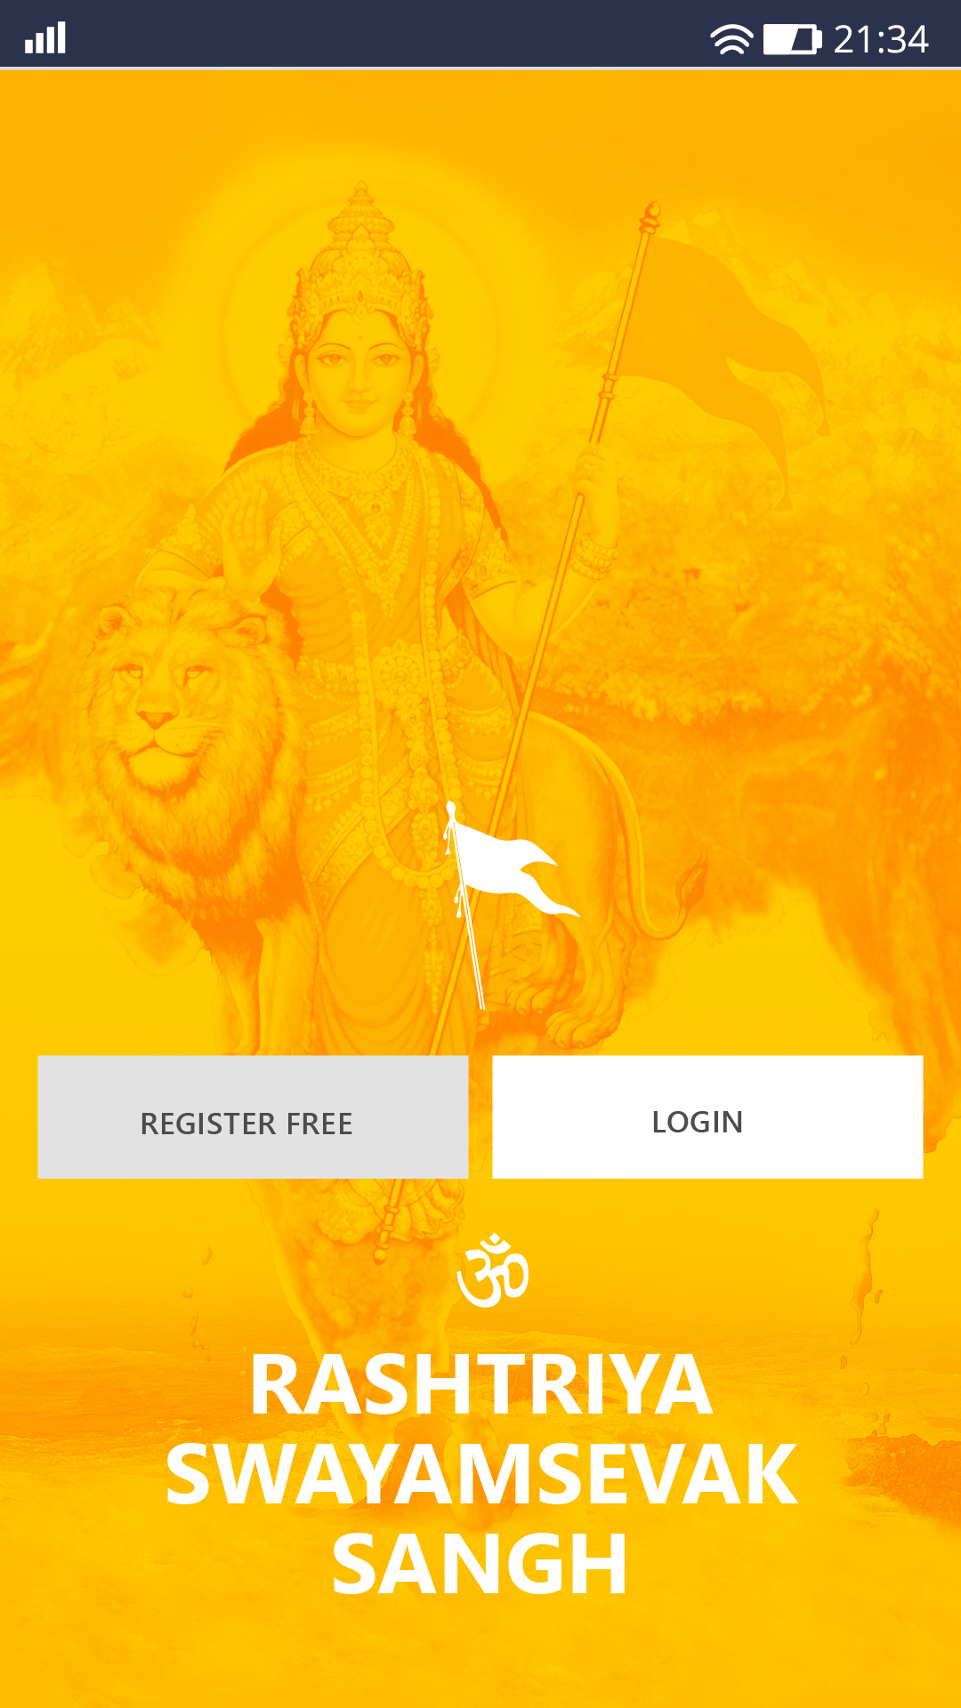
Splash Screen

Slide 3
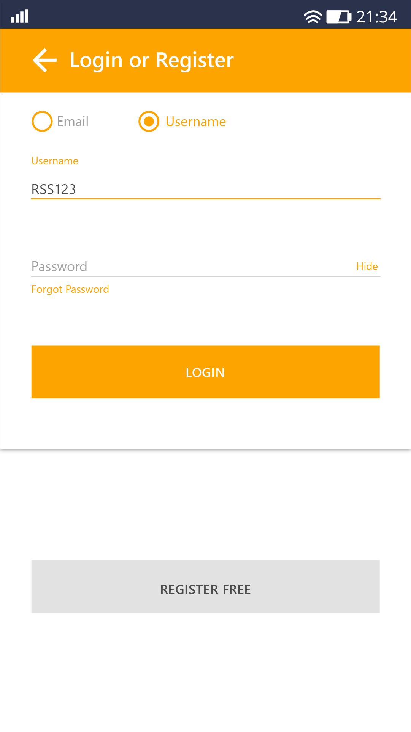
Login or Register

Slide 4
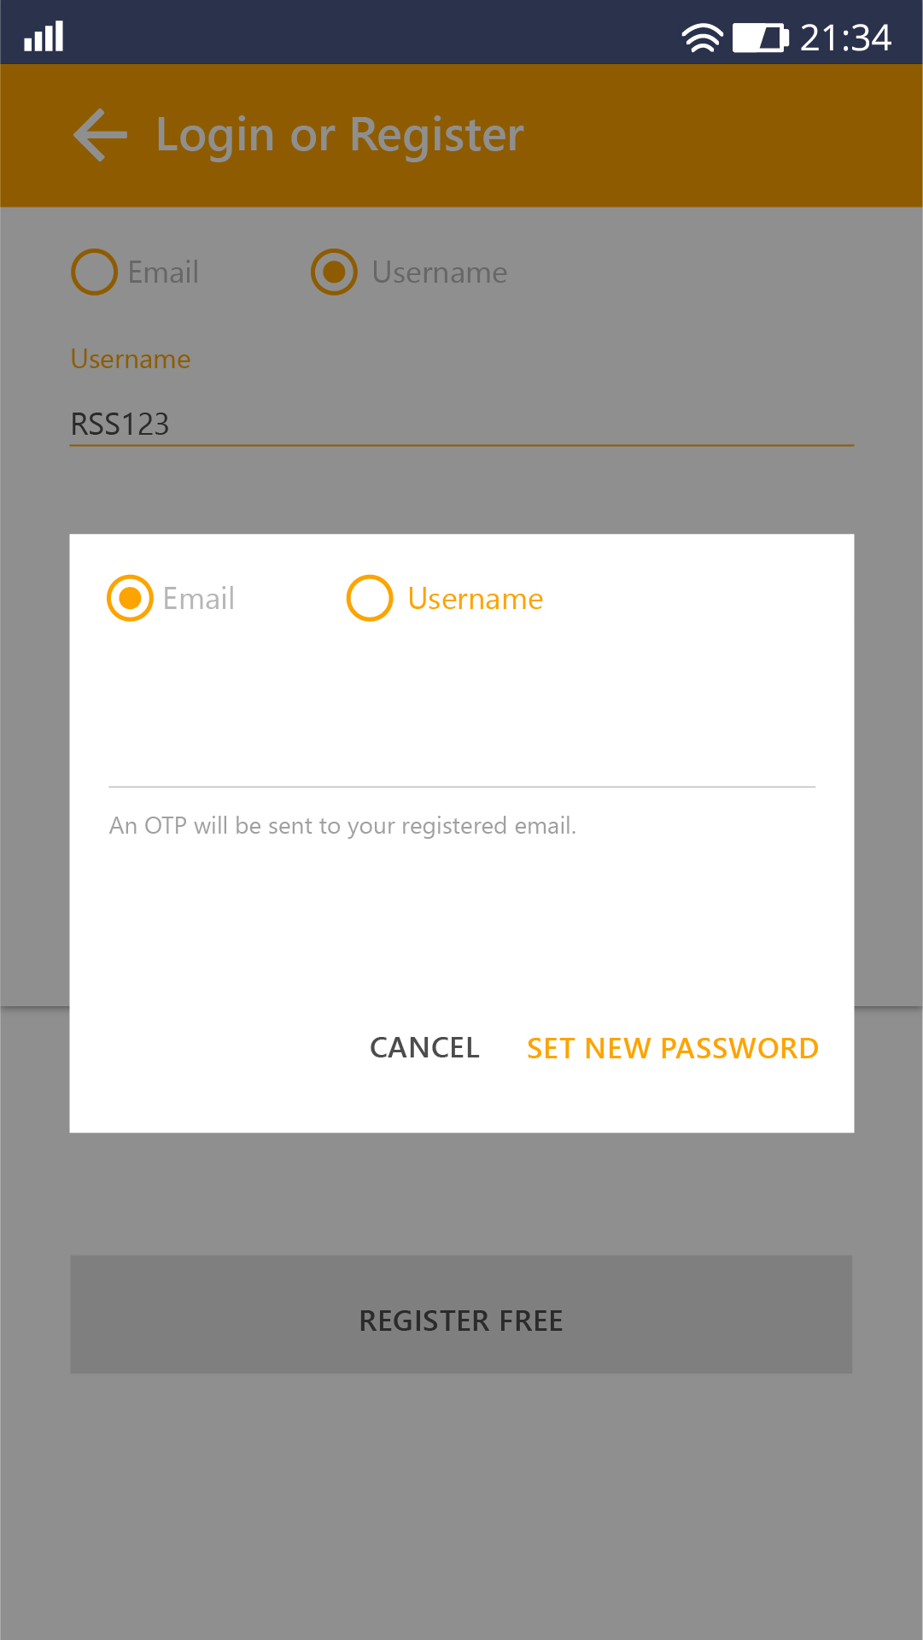
Forgot Password

Slide 5
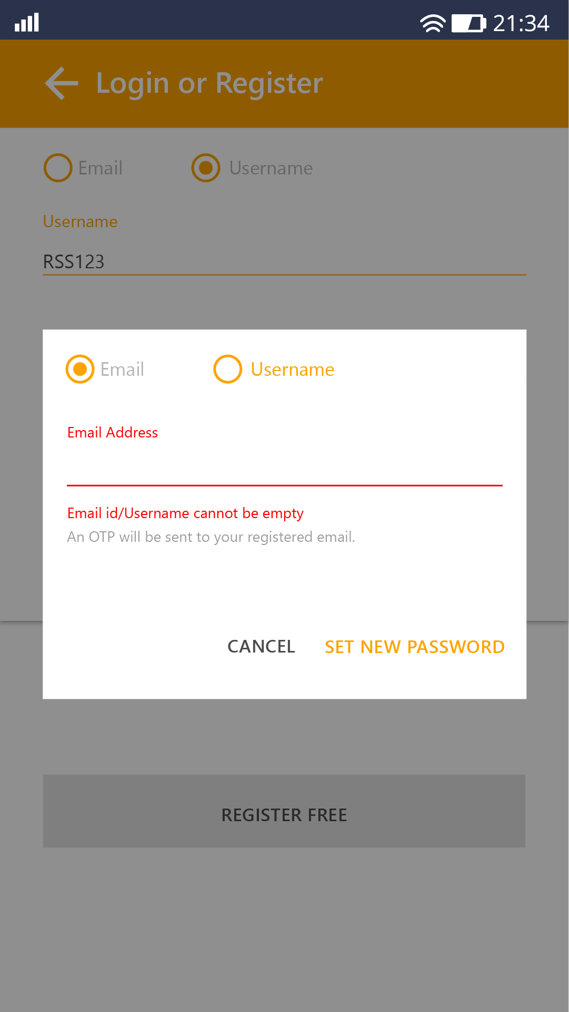
Fill Password
Password should be filled before clicking the ‘SET NEW PASSWORD’ button

Slide 6
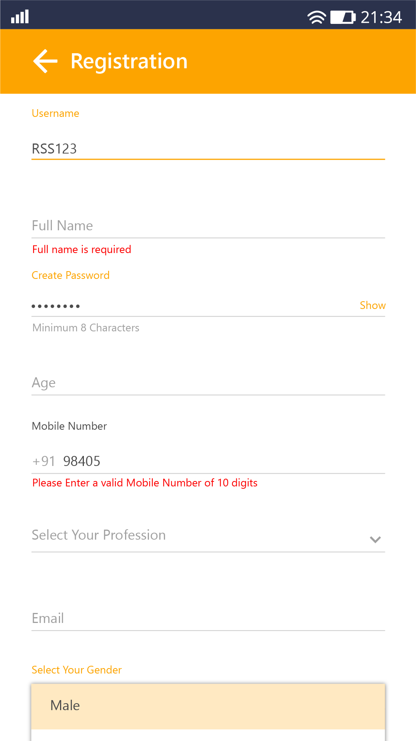
Registration
v
All details regarding the registration is seen

Slide 7
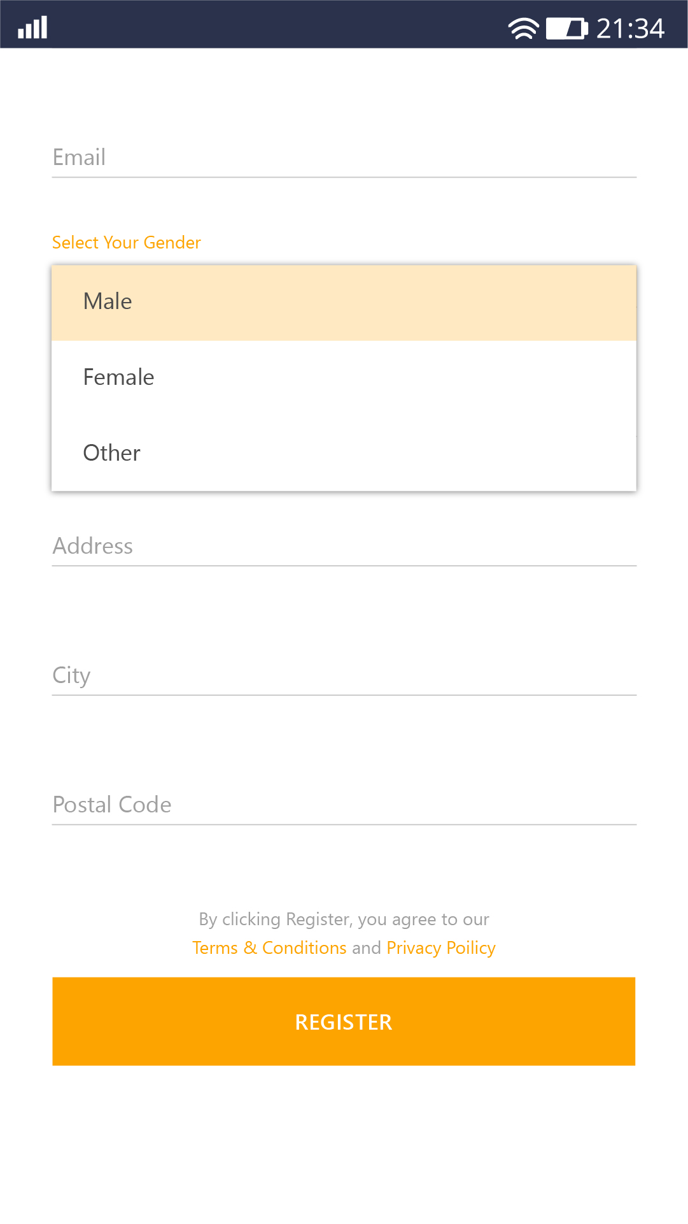
Registration
v
All details regarding the registration is seen

Slide 8
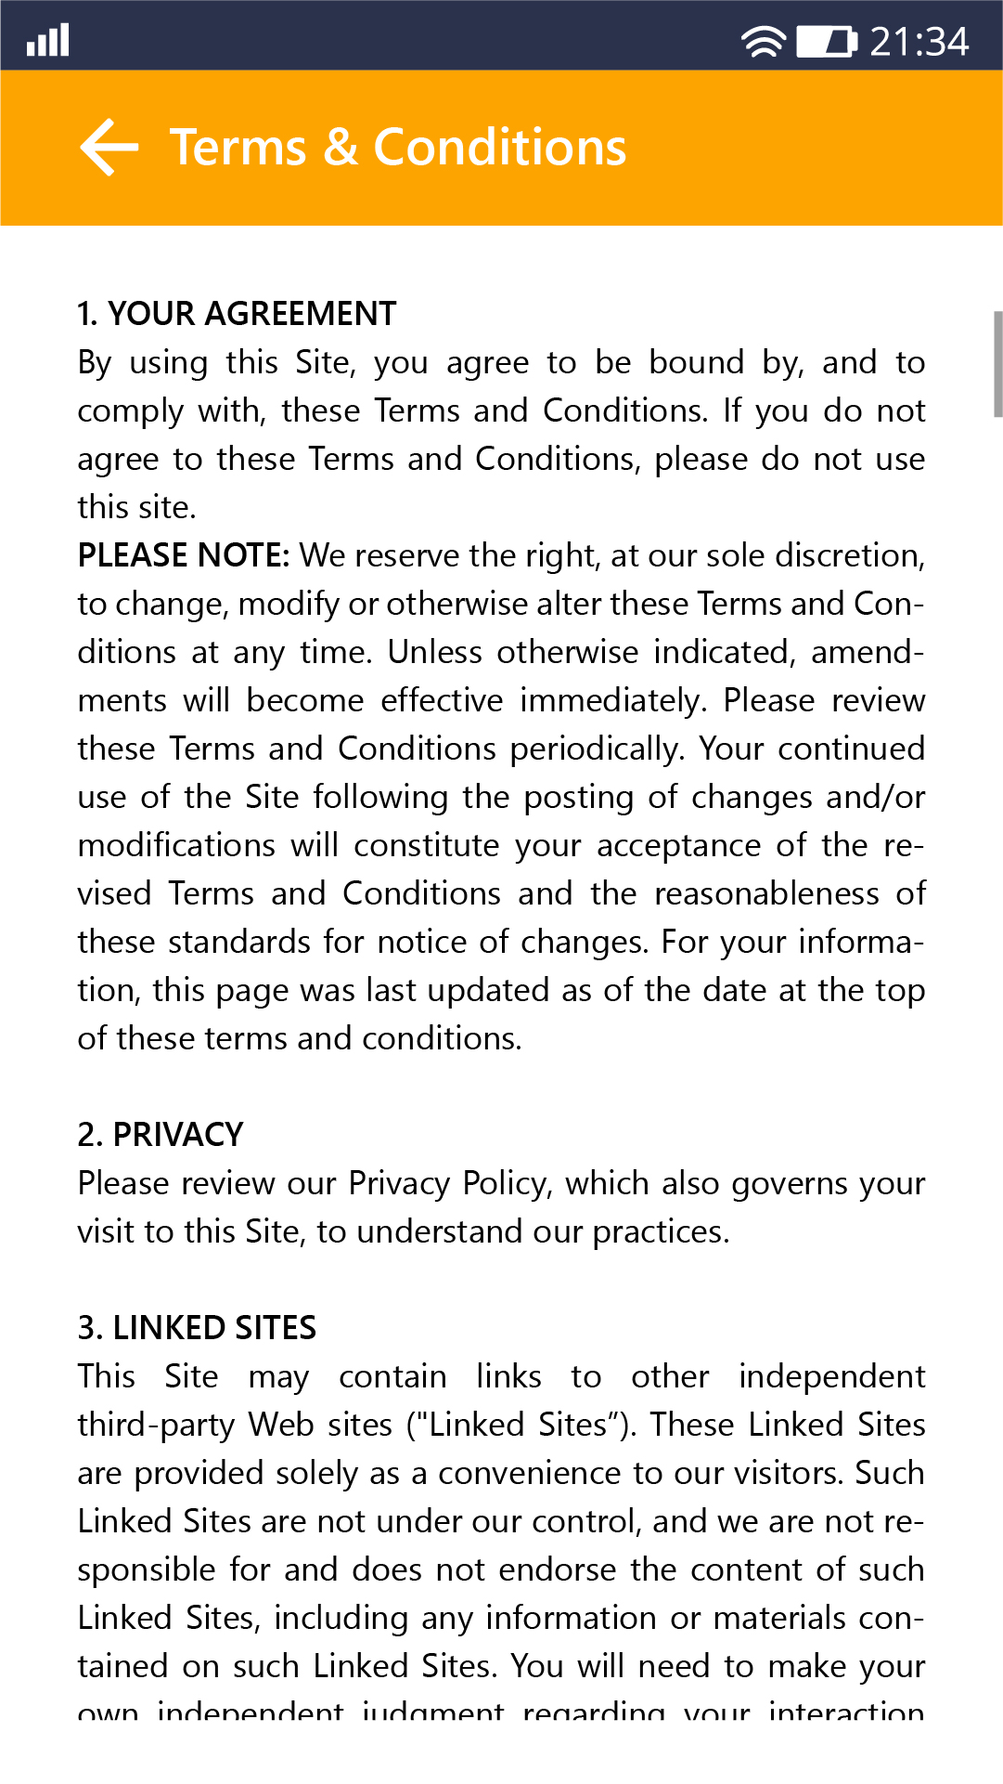
Terms & Conditions
v

